Slide 1




NeurIPS 2020 L2RPN Robustness and Adaptability Tracks Competition Winning Approach
YANG Zhihong, XU Chunlei, LU Jixiang*, XU Hongsheng, XU Kang,
CHEN Tianyu, XU Zhilin, LIU Junjun, LU Jinjun, CHEN Tianhua
(* Corresponding author)

Slide 2

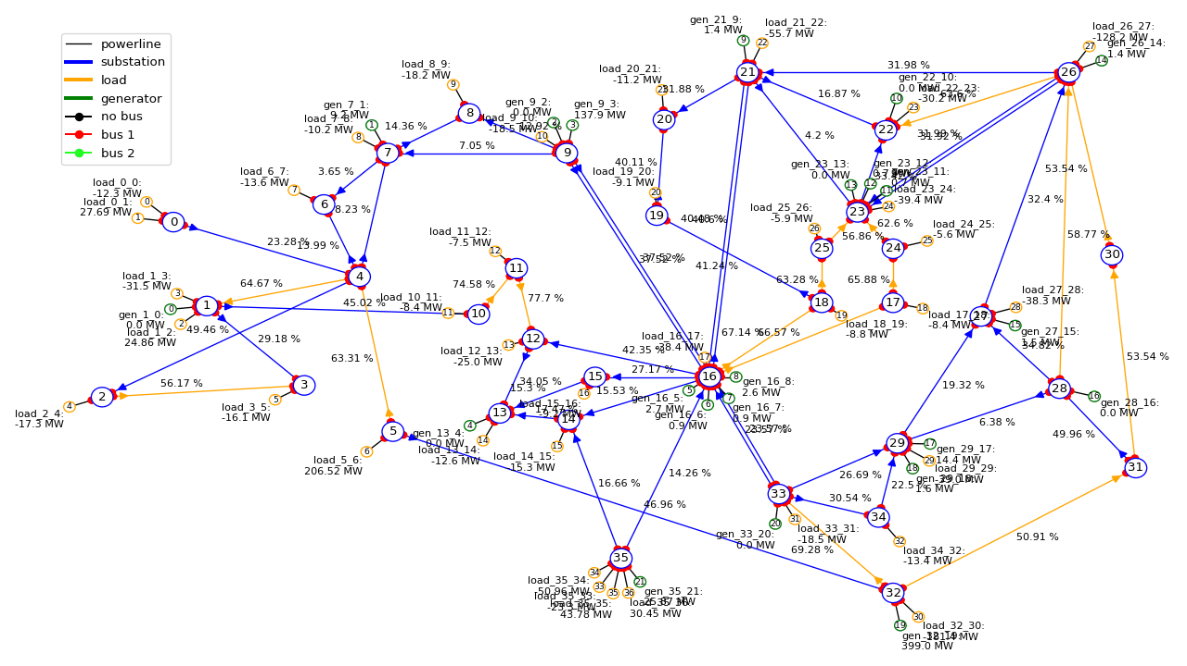


Track1 ：Robustness Track
Problem description
Methodology
Tricks
An adversarial opponent will attack some lines of the grid everyday randomly.
Results
Goal: Develop agent to be robust to unexpected events and keep delivering reliable electricity everywhere even in difficult circumstances.
Operation Cost: Operate the grid as long as possible, minimize the operation cost including powerlines losses, redispatch cost and blackout cost (penalty).

Slide 3
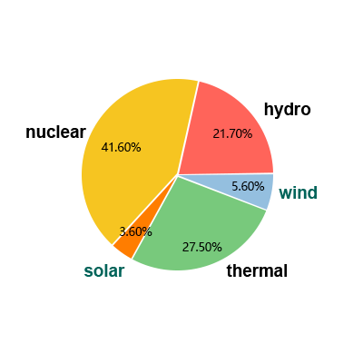

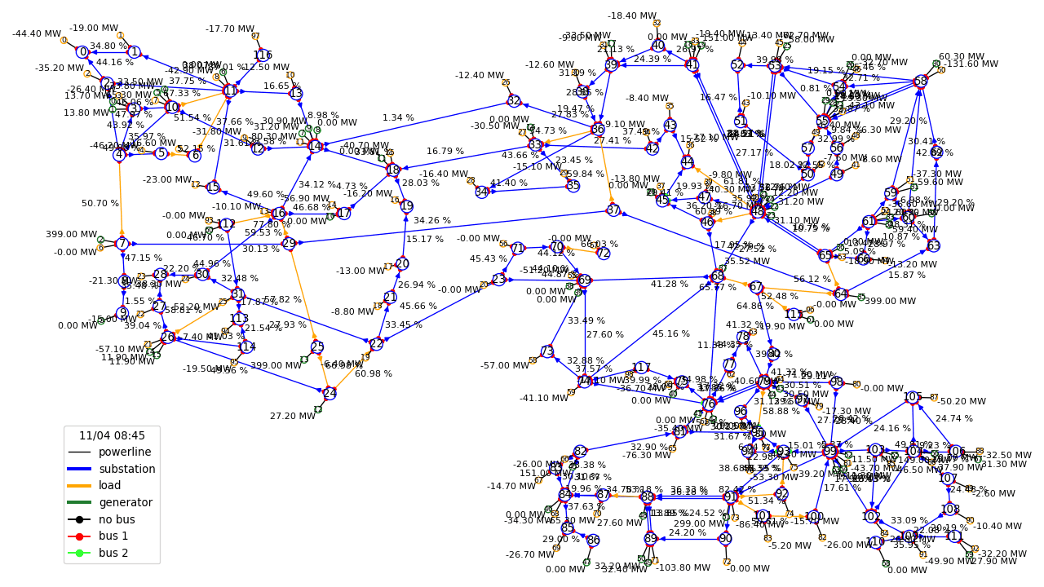
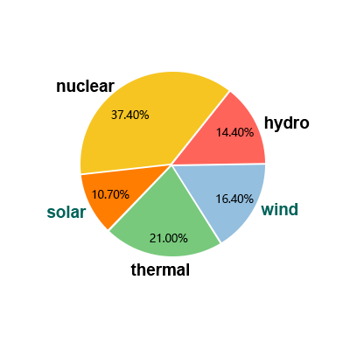
Track2：Adaptability Track
Problem description
Methodology
Renewable energies varying from 1x to 3x
Tricks
Results
Goal: Develop agent to adapt to new energy productions in the grid with an increasing share of renewable energies which might be less controllable.
Operation Cost: Operate the grid for as long as possible, minimize the operation cost including powerlines losses, redispatch cost and blackout cost (penalty).

Slide 4
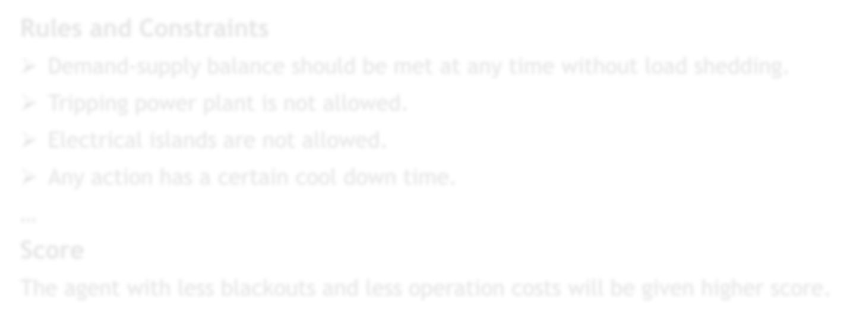
Rules and Score
Problem description
Rules and Constraints
Demand-supply balance should be met at any time without load shedding.
Tripping power plant is not allowed.
Electrical islands are not allowed.
Any action has a certain cool down time.
…
Score
The agent with less blackouts and less operation costs will be given higher score.
^{C}operations ^{(t) = C}loss ^{(t) + C}redispatching ^{(t)} C_{blackout} (t) = Load (t)* β * p(t), β ≥ 1
Methodology
Tricks
Results
^{t}end
T_{e}
^{C(e) = ∑ C}operations ^{(t) + ∑ C}blackout ^{(t)}
t =1
^{t =t}end
N
Score = ∑ C(e_{i} )
i=1

Slide 5
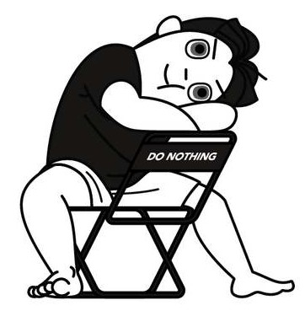
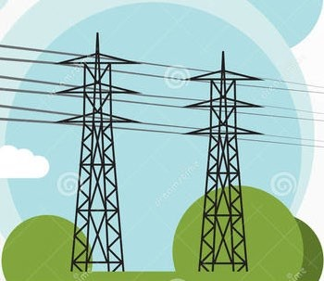
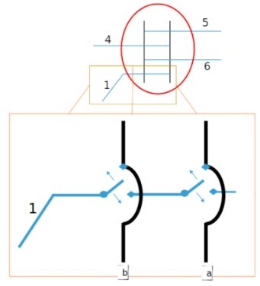

Action
Problem description
Do-Nothing action
Methodology
Powerline Status action: reconnecting / disconnecting a power line
Tricks
Results
Substation Topological action: switching busbar connection between double busbars for each substation object.
Generation redispatch action: modifying the production set point with redispatching

Slide 6
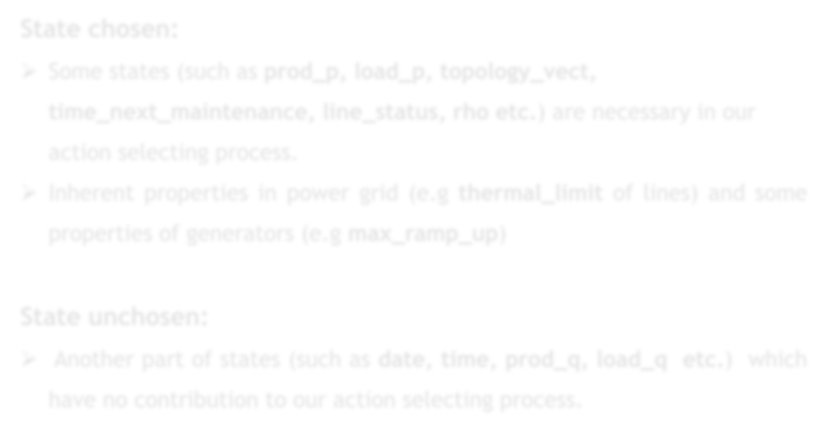
State
Problem description
State chosen:
Some states (such as prod_p, load_p, topology_vect, time_next_maintenance, line_status, rho etc.) are necessary in our action selecting process.
Inherent properties in power grid (e.g thermal_limit of lines) and some properties of generators (e.g max_ramp_up)
Methodology
Tricks
Results
State unchosen:
Another part of states (such as date, time, prod_q, load_q
have no contribution to our action selecting process.
etc.)
which

Slide 7
Dual-agent strategy
Problem description
Y
Do nothing
State Update
Methodology
Grid state
(Load & generator fluctuation, Attack& maintenance)
Operate normally?
N
Base Agent
Action
ENV
Tricks
Selected emergent transition sample (s,a,r,s´)
N
Emergency?
Results
Base Agent: Based on prior knowledge and simulation result, handling some relatively easy-to- solve situations if grid operates abnormally.
DRL Agent: Based on Dueling-Double-DQN, handling complicated situations if base agent can’t.
Y
DRL
Agent
Update Agent
Prioritized Replay Buffer
Sampled batch
*Inspired by the works of Ziming Yan, Yan Xu, Nanyang Technological University
(https://github.com/ZM-Learn/L2RPN_WCCI_a_Solution)

Slide 8
Base-agent strategy
Problem description
Methodology
Problem causes: 1.cyber-attacks 2.Hazards 3.Maintenance 4.Load
Line disconn ected?
N
Any overflow?
Y
Overflow time>3?
Y
Line get disconnected
Tricks
fluctuations
Y
N
N
Results
Line Reconnect
Do Nothing
Topo/Redisp/LineDisc

Slide 9



DRL agent
Problem description
We adopt the Dueling-Double-DQN(D3QN) algorithm for our DRL agent, a kind of value based algorithm which can handle discrete action-space problems.
Methodology
V(s)
Tricks
Q(s,a)
=A(s,a)+V(s)
Results
State
A(s,a)
D3QN Neural network structure diagram
Robustness Track: State size=744，Action size=885 Adaptability Track: State size =2300，Action size =1164

Slide 10

Rewards
Problem description
Rewards: (factors considering)
Sandbox - economic
Close-To-OverFlow - overflow
Distance - difference with initial topology 4.Line-capacity – available transfer capacity
Methodology
Tricks
Robustness Track （Track1)
Sandbox-Reward
Close-To-OverFlow-Reward
Distance-Reward
Adaptability Track （Track2）
Sandbox-Reward
Close-To-OverFlow-Reward
Distance-Reward
Lines-Capacity-Reward
Results
Reward=∑Weight(i)*Reward(i),i∈(Sandbox, CloseToOverflow, Distance, LineCapacity)

Slide 11
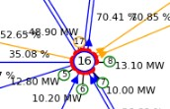


Reduced Action-space
Problem description
Robustness Track（Track1)
Adaptability Track （Track2)
Before reduce: 130k (2^17 = 131,072)
After reduce: 885
Before reduce: even more!
After reduce: 1164
Methodology
Tricks
58 line, 786 topo, 40 redisp, 1 donothing
185 line, 978 topo, 1 donothing
Results
Why action-space need to be reduced?
The topology action number is huge due to complex action combination.
Difficult for system simulation and agent training.
We reduce them according to domain knowledge and experiments.

Slide 12



Guided exploration
Problem description
Epsilon-greedy exploration
Q1 Q2
Q_highest Q_2nd
Methodology
sort
State
DNN
Large Action-space
Long MDP chain
Local optimum
Tricks
Qn
Q_lowest
Results
Guided exploration
Q_highest Q_2nd
Pick top5 Q- value, Simulate
and sort
Score_highest Score_2nd
…
Stable
Better experience
Efficient
Q_lowest
Score_lowest

Slide 13
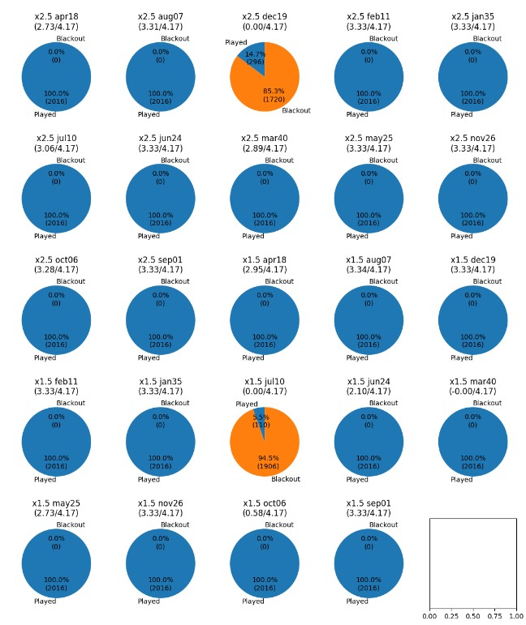
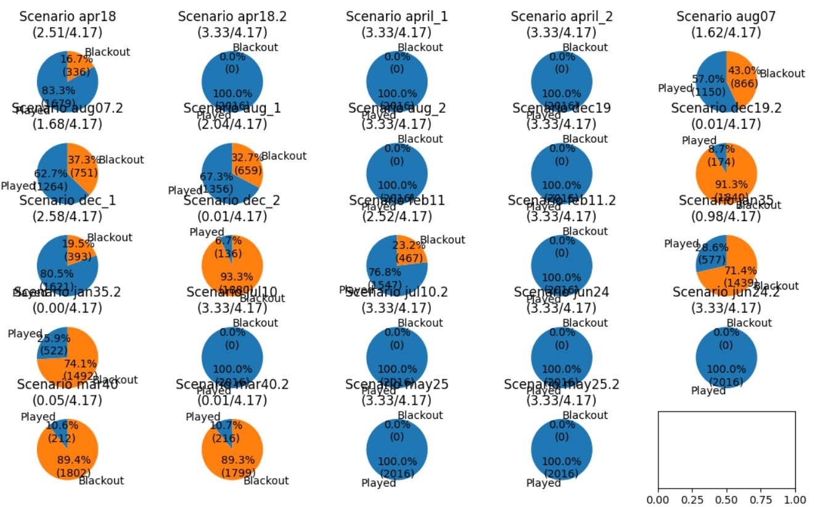

Results
Problem description
Methodology
Tricks
Results
Robustness Track Test Result
Adaptability Track Test Result
50-year simulated training data and 24-week test data for each competition track.
Blue indicates scenarios passed, orange indicates scenarios black-out.
We will optimize our agent for the failed cases in future work.

Slide 14

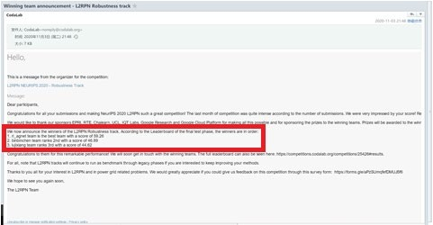
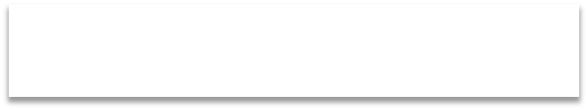


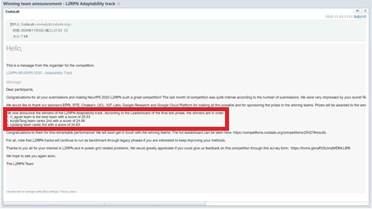


Results
Problem description
Robustness Track:
Methodology
1.rl_agent team is the best team with a score of 59.26 2.binbinChen team ranks 2nd with a score of 46.89
3.lujixiang team ranks 3rd with a score of 44.62
Tricks
Adaptability Track:
Results
1.rl_agent team is the best team with a score of 25.53 2.kunjieTang team ranks 2nd with a score of 24.66
3.lujixiang team ranks 3rd with a score of 24.63
We are one of top performers in both NeurIPS Robustness Track and Adaptability Track competitions.

Slide 15
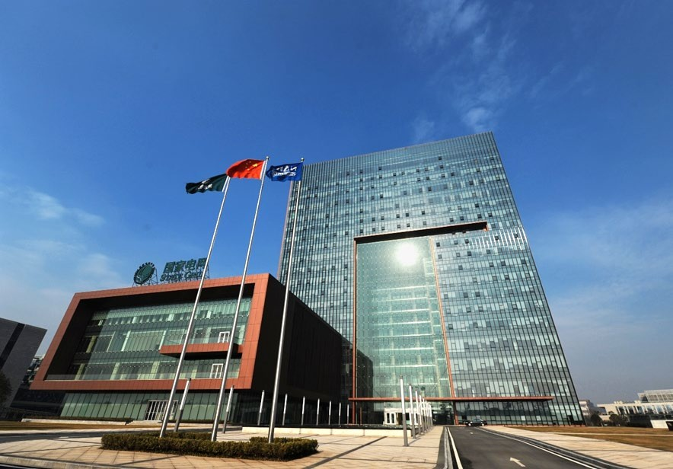
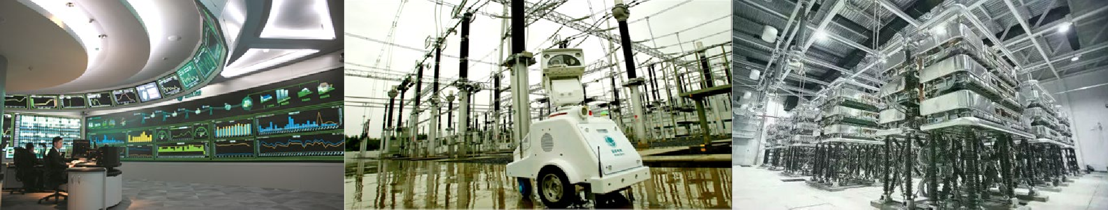
Thanks！

